Slide 1

Digital Portfolio: Showcasing Academic and Professional Growth
Presented by: VIJAYALAKSHMIRegister No & NMID: 24131021802522056Department: B.Sc. Computer ScienceCollege: KNC College for Women / Annamalai University

Slide 2
Project Title
"SkillSpark": Empowering Students Through Interactive Digital Portfolios
A comprehensive platform designed to curate, showcase, and amplify student achievements and capabilities in the digital realm.

Slide 3
Agenda: Navigating Our Journey
01
02
03
Problem Statement
Project Overview
End Users
Identifying the challenges in traditional student showcasing.
Introducing SkillSpark and its core objectives.
Who benefits from this innovative platform?
04
05
06
Tools and Technologies
Portfolio Design & Layout
Features & Functionality
The foundational stack behind SkillSpark.
Crafting an intuitive and visually appealing user experience.
Exploring the powerful capabilities of SkillSpark.
07
08
09
Results & Screenshots
Conclusion
GitHub Link
A glimpse into the deployed platform.
Summarizing our impact and future vision.
Accessing the project source code.

Slide 4

The Problem: Bridging the Gap
Traditional resumes and static documents often fail to capture the full scope of a student's skills, projects, and creative work. They lack interactivity and dynamism, making it difficult for students to stand out in a competitive landscape.
Limited showcase of practical skills
Difficulty in demonstrating project complexities
Lack of a centralized, accessible platform
Challenges in presenting multimedia content

Slide 5
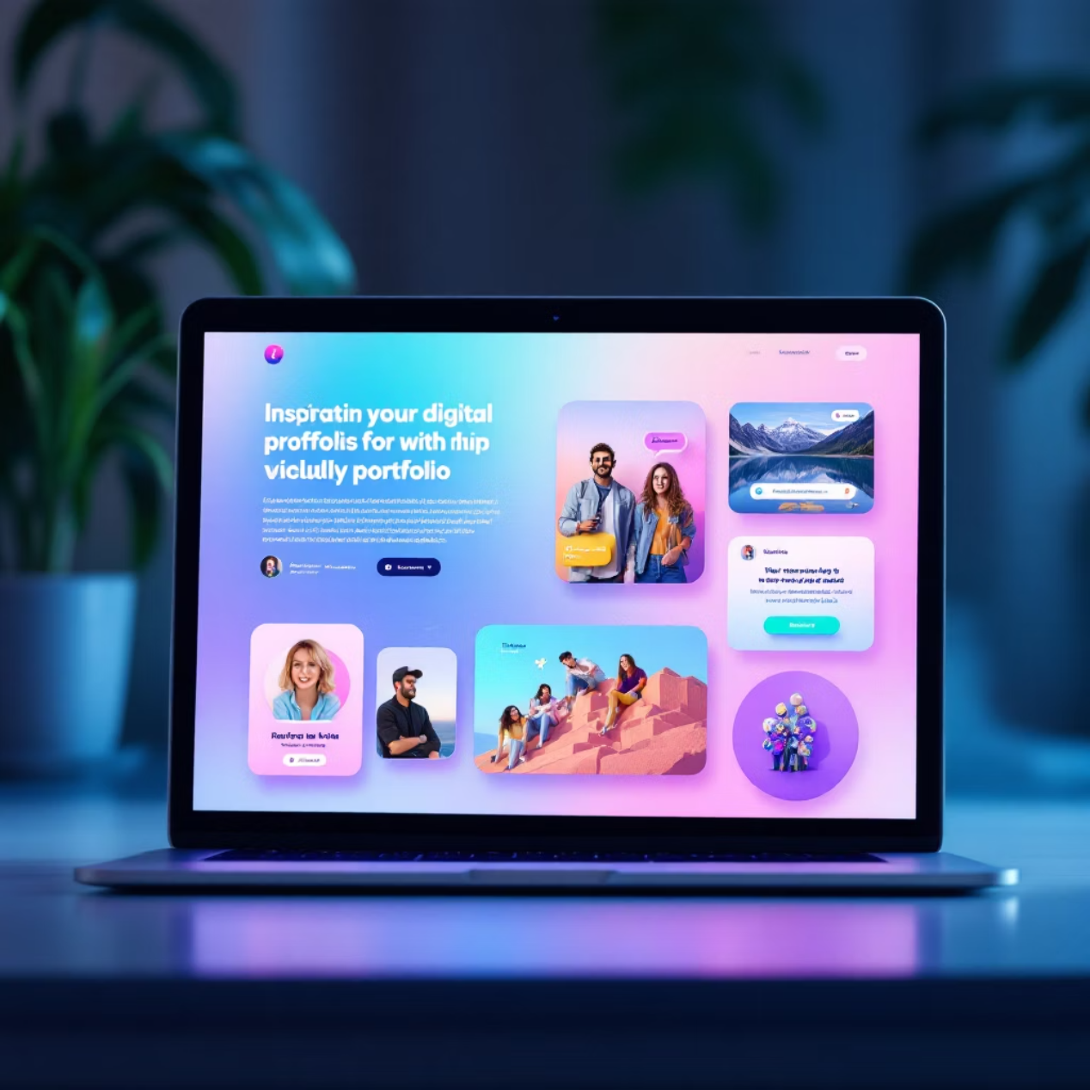
Project Overview: Introducing SkillSpark
SkillSpark is an innovative digital portfolio platform designed to empower students to effectively showcase their academic achievements, practical projects, certifications, and extracurricular activities. It offers a dynamic and interactive way to present skills beyond what a traditional resume can convey.
Interactive Presentations: Embed videos, code snippets, and live demos.
Personalized Branding: Customizable themes and layouts to reflect individual style.
Analytics & Insights: Track visitor engagement and portfolio performance.

Slide 6




Our Key End Users
Students
Recruiters
Seeking to present their comprehensive profile to prospective employers or for higher education applications.
Looking for talented individuals with tangible proof of skills and project experience.
Academic Institutions
Collaborators
For faculty to assess student progress and for universities to highlight alumni achievements.
Students connecting with peers for group projects, internships, or shared learning opportunities.

Slide 7
Tools and Technologies Powering SkillSpark
Frontend
HTML5, CSS3: For structuring and styling the web content.JavaScript (React.js): For building dynamic and interactive user interfaces.Material-UI: A popular React UI framework for sleek and responsive design components.
Backend
Node.js with Express.js: For building robust and scalable server-side applications and APIs.MongoDB: A NoSQL database for flexible and efficient data storage.
Deployment & Version Control
Git & GitHub: For version control and collaborative development.Heroku / Netlify: For seamless deployment and hosting of the application.
Design Tools
Figma: For collaborative UI/UX design and prototyping.

Slide 8
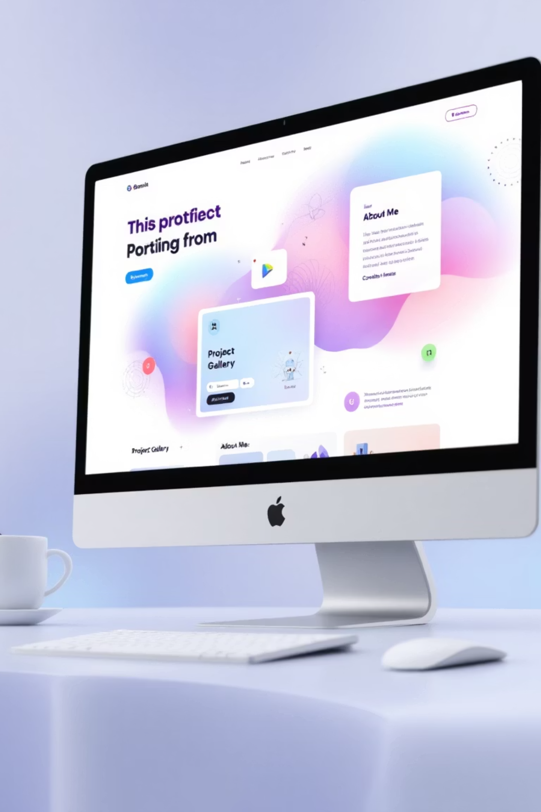
Portfolio Design and Layout: A Glimpse into SkillSpark's Interface
SkillSpark features a user-centric design with intuitive navigation and customizable layouts. Students can choose from various templates, upload diverse media types (images, videos, PDFs), and organize their work into categories. Key elements include:
Dynamic Project Galleries: Visually appealing sections for showcasing projects with detailed descriptions.
Skills Matrix: An interactive representation of skills with proficiency levels.
Integrated Contact Forms: Easy for visitors to connect.
Responsive Design: Optimized for viewing across all devices – desktop, tablet, and mobile.

Slide 9
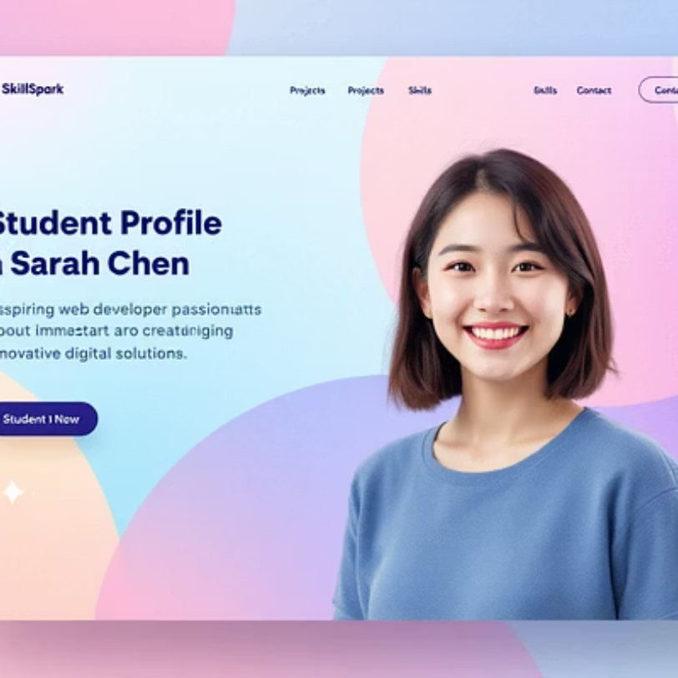
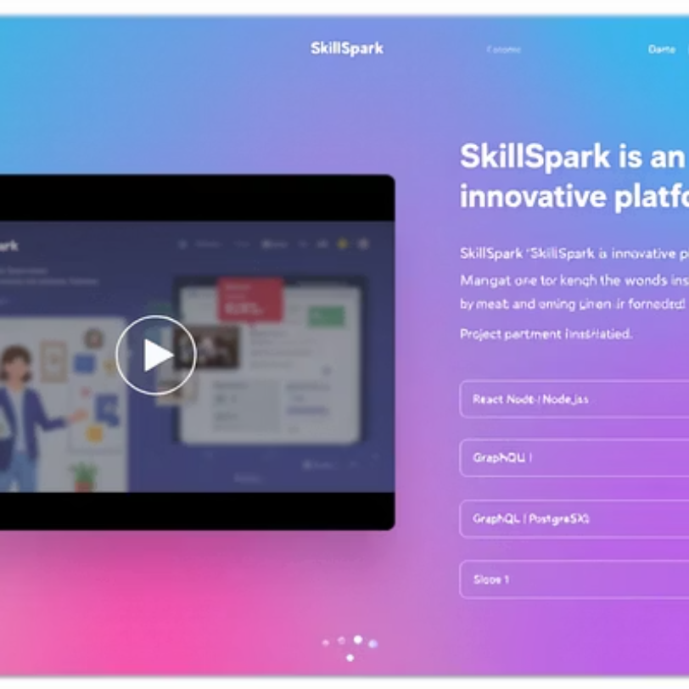
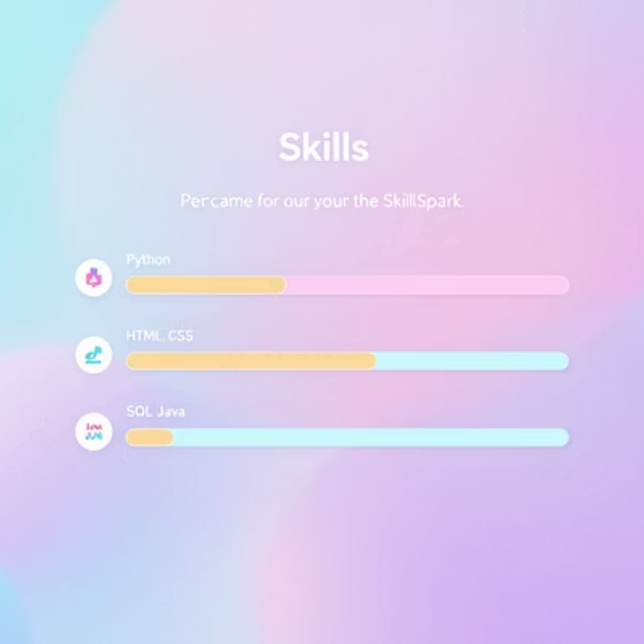
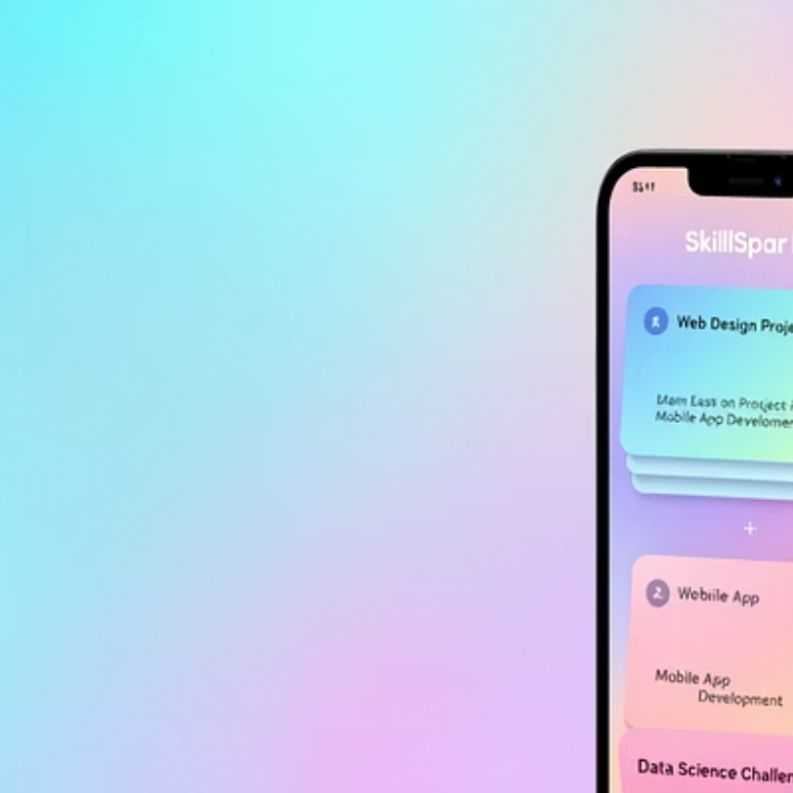
Results and Screenshots: SkillSpark in Action
These screenshots illustrate the clean, intuitive, and visually appealing interface of SkillSpark, demonstrating its functionality across various sections and devices.

Slide 10
Conclusion: Empowering Future Leaders
"SkillSpark transforms how students showcase their potential, making their unique talents truly visible to the world."
Key Takeaways:
Enhanced visibility for student talents.
Interactive and comprehensive project showcasing.
The digital portfolio is more than just a collection of work; it's a dynamic representation of a student's journey, growth, and aspirations. SkillSpark provides the ideal platform for this, bridging the gap between academic achievements and professional opportunities.
Improved connections between students and industry.
Next Steps:
Integration of AI-powered portfolio suggestions.
Community features for peer collaboration.
GitHub Link: https://github.com/vijayalakshmi/skillspark-portfolio

